Slide 1
NASONEX 2012 Consumer Discussion
January 2012

Slide 2

Objectives
2011 DTC Strategy and Segmentation
2011 ROI Results from Promotional Analytics
2012 Creative Execution and Quant results
2012 Exploratory Discussion

Slide 3

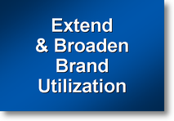

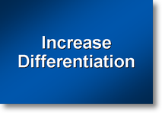

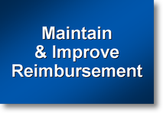
Strategies Focused on Three Key Segments: HCP, HCC, Payer
Increase
Brand Utilization
Maintain sustained share of voice to key customers
  #2 Priority for Port 1
  Year round personal and non-personal selling efforts
  Protect and grow branded leadership vs. existing and new competitive entries
  Manage generic erosion
Lead with efficacy with key customers to increase brand utilization
Patient activation
  Drive branded awareness, when and where it is most important, to acquire new patient starts (& re-initiate patients)
Patient retention
  Protect patient base by supporting use any time of year, to retain existing patients and drive appropriate refill practices
Drive Patient Acquisition and Persistency
Maintain
Profitable Access
Maintain leading branded 2nd tier access
Maximize market share performance and optimize profitability
For Internal Use Only. Not to Be Discussed with Customers.

Slide 4
Consumer Strategy –
NASONEX
Motivate new patients to ask for NASONEX, during spring/fall season and year-round, reinforcing the powerful relief of symptoms from a wide variety of allergens
Re-activate existing patients on NASONEX to ask visit their doctor and ask for a refill.
Strategic
Objective
Behavioral
Objectives
Communication
Objectives
Acquisition of new-to-brand AR patients
Activate consumers to ask their doctor/child’s doctor for NASONEX
Build awareness of NASONEX as an Rx treatment for allergic rhinitis that works on the most bothersome symptoms, congestion and others, year round.
Reinforce past success of NASONEX as an Rx treatment for allergic rhinitis that works on symptoms, caused by indoor and out door allergens, year-round.
Re-acquisition of past AR patients
Re-Activate past patients to ask their doctor/child’s doctor for NASONEX
Retention of current AR patients
Activate current patients/parents to re-fill their Rx
Reinforce/confirm the benefits of NASONEX as a treatment for allergic rhinitis, and it’s role as an Rx treatment that works year round.

Slide 5
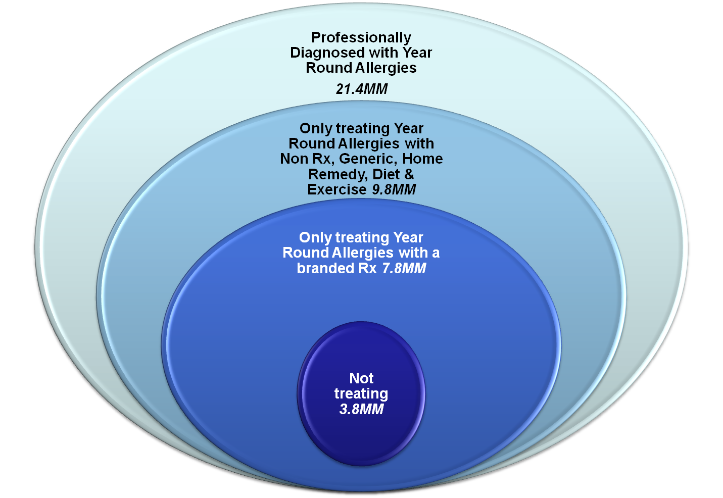
Impact Business by focusing in on those most affected by their allergies who choose DTC over OTC
~40MM Suffer and haven’t seen a MD yet, choosing OTC
Total Allergy suffers estimated 60MM+
Source: MARS 2011 OTC/DTC Study

Slide 6
2009-2011 ROI Analysis

Slide 7
ROI Analysis Results
This analysis suggest that investments in Nasonex® TV media, production, talent and agency fees were profitable during the studied time period (August 2009 through July 2011) with an approximate ROI of $2.7:$1.
The modeling approach suggests:
  that within the experience range the response is linear and does not show any saturation
  that an increase in media investment of approximately $5MM vs. historical investments may increase the profits from the investment by $10MM.
  Second half of the year is more impactful per Ad than the first half of the year.
  45 second Ads were aired during first half of 2011. During 2009-2010 time frame, 30 second ads were aired. In terms of total Ad seconds, 2011 Ad activities were similar to 2010 activities during the same time period.
  The total TV DTC impact in first half of 2011 was not statistically different from the corresponding time period in 2010.
  By holding the current spend during first semester and increasing the second semester GRPs by $1MM, an estimated additional incremental revenue of about $5.9MM may be possible (a more conservative estimate would be about $3.6MM).

Slide 8
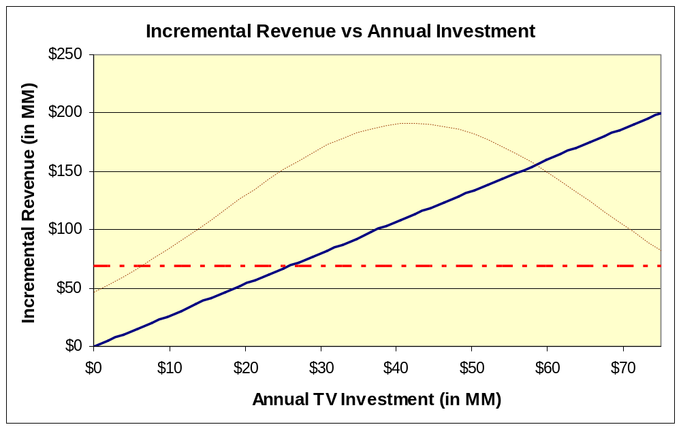
Incremental Revenue by Total pre-tax Investment
This incremental revenue vs. pre-tax annual DTC TV spend chart shows a revenue of about $112MM for the average pre-tax annual TV DTC spend of about $42MM. The estimates have higher confidence in the narrow range around the mean annual spend.
Historical annual TV investment
Dotted red line represents the incremental revenue lost to OTC TV Ads.
The modeled curve is linear, implying that as DTC spend increases, the revenue also increases proportionately. Further non-parametric studies suggests that within the data experience range, the saturation effect could not be observed.
The dotted red line shows the revenue loss due to OTC TV Ads during the year. About $26 MM of Annual TV investment is required to negate the impact of OTC TV Ads on Nasonex NRx. In addition, after Allegra OTC launch in March 2011, the TV spend for Allegra OTC has increased drastically, hence moving forward, a higher negative impact of OTC TV ads may be observed.
Study Period: Aug-2009 to Jul-2011

Slide 9
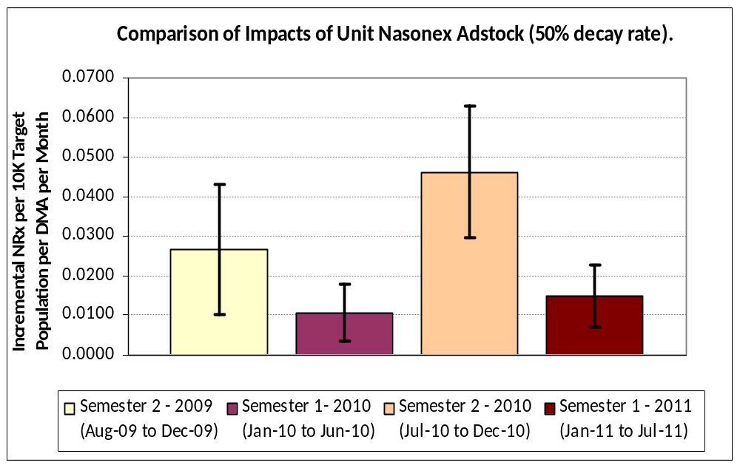
TV Campaign Impacts across Semesters
Per :60 second GRP Adstock, First half of 2011 was as effective as that of 2010. Also, per Adstock, Semester 2’s are more responsive than Semester 1.
Second half of the years (Semester 2’s) are more responsive per GRP Adstock than First half of the years (Semester 1’s).
First half of 2011 is as responsive (per weighted GRP Adstock) as Semester 1 of 2010 as their confidence intervals overlap.
This represents 95% confidence Interval. For first half of the year, both 2010 and 2011 estimates overlaps, suggesting that they are not different statistically.
Semester level estimates here were obtained from supporting models. They are more appropriate in making relative comparisons.
Study Period: Aug-2009 to Jul-2011

Slide 10
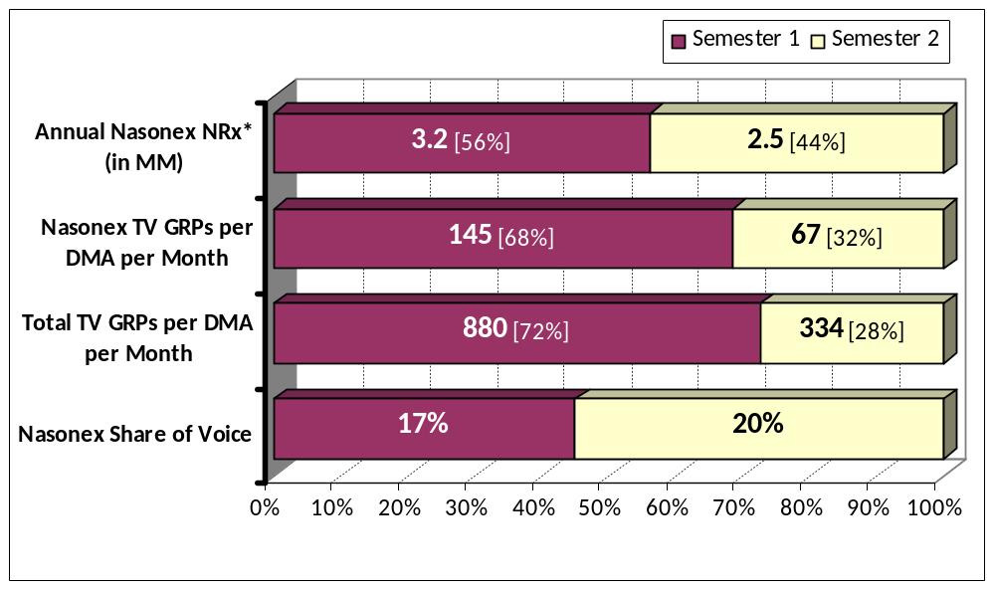
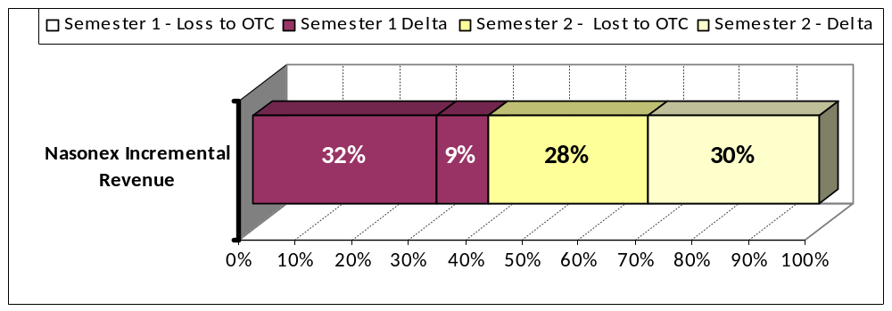
TV Campaign Trends: First and Second Semesters
Total TV Voice in Semester 2 is much lower than Semester 1. Semester 2 contributes about 59% of total 3 year pre-tax revenue generated. Semester 1 Ads are mostly spent in negating the effects of OTC Ads.
Nasonex NRx in first half of 2010 is about 56% of total NRx in 2010.
Semester 1 Nasonex TV GRP is about 68% of yearly GRPs. This % is higher when compared to NRx split.
Total voice in Semester 2 is much lower than in Semester 1.
OTC TV campaigns have a negative impact on Nasonex NRx.
  In Semester 1, most of the Nasonex TV campaign just goes to negate the effects of high OTC campaigns during these periods.
Since the launch of Allegra OTC in 2011, their TV campaigns have increased substantially and probably all the Nasonex Semester 1 campaign effects are negated by the OTC campaign.
One recommendation would be to hold the Semester 1 GRPs at current (or slightly higher) level and increase the Semester 2 GRPs to achieve a higher annual incremental revenue.
* Annual NRx in the chart is based on year 2010. All other metrics are study period averages per DMA per Month
Study Period: Aug-2009 to Jul-2011

Slide 11
2012 Creative and Message

Slide 12






“Seasonal Words”
Nasonex TV :45
WOMAN: Achoo!
BEE: Nasal allergy
symptoms like
BEE: congestion,
BEE: runny nose,
BEE: itchy nose
BEE: and sneezing can hit
you year-round, indoors or out.
BEE: Prescription Nasonex

Slide 13

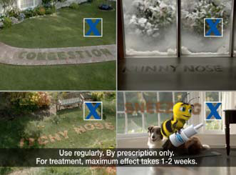
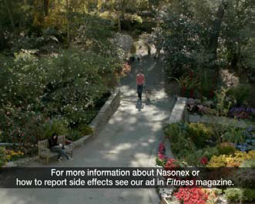

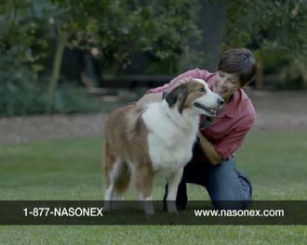
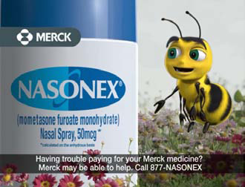
“Seasonal Words”
Nasonex TV :45
BEE: is clinically proven to
help relieve nasal allergy symptoms any time of year.
NARRATOR VO: Side effects may include headache, viral infection,
sore throat, nosebleeds, and coughing.
NARRATOR VO:
Infections of the nose and
throat and eye problems,
including glaucoma or cataracts may occur. Have regular eye exams.
NARRATOR VO: Slow wound healing may
occur, so do not use Nasonex until your nose has healed from any sore, surgery or injury.
NARRATOR VO: Nasonex can increase your risk of getting infections. Avoid contact with infections like chicken pox or measles while using Nasonex.
BEE: Nasonex is there for
you, anytime of year.
BEE: Ask your doctor if
Nasonex is right for you.

Slide 14

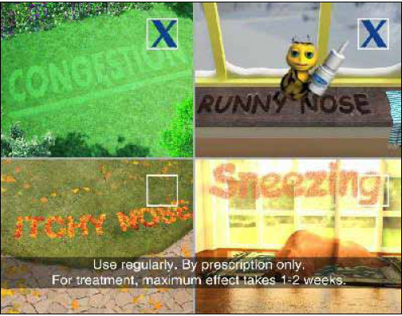
New Execution- “Seasonal Words”:45
Objective: to create an execution that would perform at parity if not better than the in-market advertisement.
OTC Dissatisfied, a subset of the overall population, are incredibly important, as they represent substantial business opportunity (~40MM consumers)
General Allergy Sufferers | Current Ad | Seasonal Words
Recall | 80% | 79%
Ask Dr. About NASONEX | 40% | 48%
NASONEX Proposition | 63% | 67%
Relives Congestion | 47% | 46%
Treats Indoor & Outdoor Allergies | 59% | 56%
Overall Corporate Reputation |  | +.3
OTC Dissatisfied | Current Ad | Seasonal Words
Ask Dr. About NASONEX | 40% | 60%^
NASONEX Proposition | 64% | 64%
Relives Congestion | 51% | 51%
Treats Indoor & Outdoor Allergies | 52% | 60%
ROI Metric Action Taking | Current Ad | Seasonal Words
% Taking Action | 15.2% | 16.4%
^ Statistically Different

Slide 15
Message Construction for NASONEX–
Qualitative research examined multiple elements of a successful message for consumers
Core Message Components: | Research Findings**:
Relieves Congestion, runny and itchy nose, and sneezing | What ultimately motivates consumers to use a medication is knowing it will relieve their symptoms. In general, consumers preferred statements listing multiple allergy symptoms, rather than statements primarily focusing on congestion. Even if congestion is their most bothersome symptom, most consumers said listing specific symptoms allows them to associate NASONEX with the symptoms they have. Also, they believe it will take care of all their symptoms, not just target one or two. **Although first and only [Congestion], captures consumer’s attention, it makes some consumers question the validity of all the messages presented, since they do not believe Nasonex is the only nasal allergy spray approved for treating their allergies in general.
NASONEX is clinically proven… | Statements that included clinically proven resonated because these phrases show that NASONEX is safe and has been tested. It implies to consumers that it has been tried on many people.
Allergies can affect you seasonally and year round | Most consumers indicated they experience seasonal symptoms, so mentioning this matches their experiences. For those who experience year-round allergies, not mentioning year-round makes them feel as though NASONEX will not work for them.
Allergies are triggered indoors and out | Overall, consumers responded favorably to mentions of indoor and outdoor allergies. It makes them feel as though NASONEX will treat any kind of allergy they may have.
  **Qual Research n=38 (Nasonex Consumer Research: Ad-Like Object Testing; Sommer Consulting; November 2009)

Slide 16
Message Construction for NASONEX–
Quantitative research confirmed the winning elements of the branded message
Winning Attention Grabbers** | Winning Benefits**
Do you frequently suffer from year-round and seasonal nasal allergy symptoms? Do you have nasal allergies caused by indoor or outdoor triggers like pollen, mold, pet dander and dust mites? Looking for powerful daily nasal allergy symptom relief during all the times of the year that you suffer? | NASONEX helps provide powerful relief for seasonal and year-round nasal allergy symptoms – including congestion, sneezing, itchy nose and runny nose Once-daily NASONEX is FDA-approved to help provide powerful nasal allergy symptom relief – any time of the year you suffer from indoor or outdoor symptoms NASONEX helps provide powerful relief for indoor and outdoor nasal allergy symptoms – including congestion, sneezing, itchy nose and runny nose
Currently Employed Messages – Quantitatively confirmed^^
“The seasons change, but you still may suffer from nasal allergy symptoms which can hit you year round…indoors or out. NASONEX is clinically proven to relieve nasal allergy symptoms including congestion, runny and itchy nose, and sneezing”
  **Quant Research n= 1,005 (Nasonex Message Testing Conjoint; Hall and Partners; January 2010)
  ^^Quant Research n= 1,177 (Touchpoint TV Concept Testing; MSW; October 2010)

Slide 17
2012 Recommendations

Slide 18
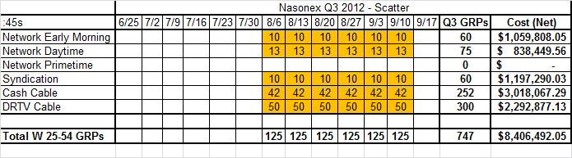
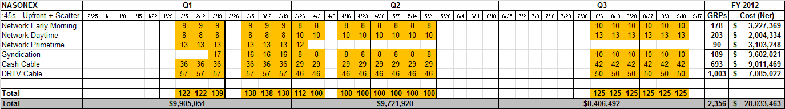
Incremental Fall TV Funding
Recommended Incremental Television: $8.4MM
  6 additional weeks on air (Aug/Sep)
  747 total GRPs
    On par with Nasonex Q3 TV levels (2008 - 2010)

Slide 19
2012 Discussion and Recommendations
Gain approval for Fall TV funding
Secure research $$ for Market Map, OTC insights and message exploration to further enhance emphasis on Congestion
Explore optimal TV spend levels
Increase focus on In-office vehicles

